Slide 1
Chapter 20: Software Testing
- Testing in Life Cycle

Slide 2
Software Testing in the Life Cycle
System Engineering
system test plan
System Testing
software acceptance test plan
Perform tests to ensure that the system satisfies system requirements & constraints
Prepare a system test plan according to system requirements & constraints
Software Requirements Analysis
Acceptance Testing
integration test
plan
Perform tests to ensure that the software system satisfies software requirements & constraints
Prepare an acceptance test plan according to software requirements/use cases & constraints
Integration Testing
Design
Perform tests to ensure that all software components interact correctly.
Prepare an integration test plan according to component dependencies, interfaces and interaction behavior
Implementation & Unit Test
Implement and test the classes using various test methods. Test-driven development is preferred.
20-<number>

Slide 3
Test Planning
A test plan prescribes activities that will be performed to demonstrate that the software product meets its requirements.
20-<number>

Slide 4
Test Plan Specification – Short Version
1. Test objectives – specify what the tests will accomplish.
2. Types of test – specify the types of tests used and aspects of the system to be tested.
3. Test methods and techniques – specify the test methods and test techniques to be used to perform the tests.
4. Test cases – specify the test cases that must be performed during the testing phase. Test cases for high-priority use cases and critical functionality of the system should be included.
5. Test coverage criteria – specify the test coverage criteria to be accomplished.
6. Documents needed – specify needed documents.
7. Required resources – specify needed human resources, hardware equipment, software components, and software tools.
8. Effort estimation and schedule – specify estimated effort required to perform the tests and a test schedule.
20-<number>

Slide 5
Test Plan Specification – Long Version
1. Test objectives, i.e., what you want to achieve by testing.
2. Entrance criteria and completion criteria (e.g., level of testing comprehensiveness (TC), estimated defects per thousand lines of code).
3. Software integration and testing strategy; grouping
of modules, an order to integrate the groups, and test
objectives for each group.
20-<number>

Slide 6
Test Plan Specification – Long Version
Methods to be used on particular modules, e.g., inspection, walkthrough, static analysis, structure testing, and/or functional testing (equivalence partitioning, boundary value analysis, cause-effect analysis).
Test case descriptions.
Responsibilities, including tasks, assignments, resources, and a schedule.
Deliverables, e.g., review reports, and test results.
20-<number>

Slide 7
Test Plan Specification – Long Version
8. Procedures, including review procedures, test procedures, problem reporting and tracking procedures, and regression testing procedures.
9. Configuration management policies, such as change control, auditing, and reporting.
20-<number>

Slide 8
Testing Performed in the Software Life Cycle
Unit Testing
Integration Testing
Validation Testing
Alpha testing, and Beta Testing
Security Testing
System Testing
Recovery Testing
Performance Testing
Stress Testing
Regression Testing
20-<number>

Slide 9
Unit Testing
Unit testing is testing of each module, or class.
It is usually performed by the developer. However, it can also be performed by peers, or testers.
Test-driven development (TDD) is required/ recommended, and it is the trend in the software industry.
Functional testing, structural testing, interface testing, security testing, and exception testing are performed.
20-<number>

Slide 10
Unit Testing
Test Driver
Results
Test Cases
initialization, execution, result collection
Component Under Test
Test Stub
Test Stub
20-<number>

Slide 11
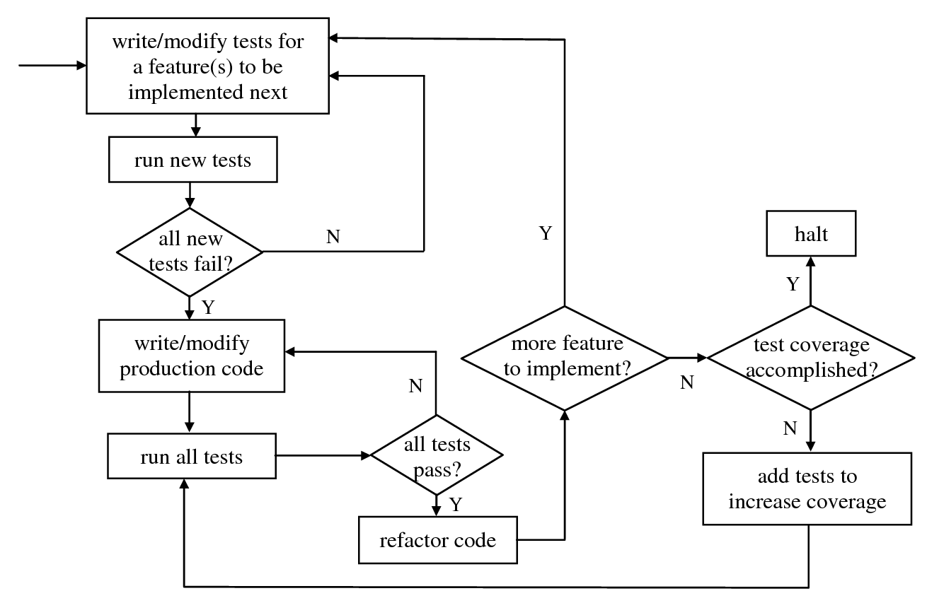
Test-Driven Development Process
See Chapter 18.6, page 463 for detail.
20-<number>

Slide 12
Integration Testing Strategies
All modules at once (big bang)
Top-down integration
3. Bottom-up integration
3. Critical or high priority modules first
4. Available modules first
5. Function oriented
7. Any combination of above
20-<number>

Slide 13
Top Down Integration Testing
Level 0
Level 1
stub
Level 1
stub
Level 1
Level 1
Level 2
Level 2
Level 2
Level 2 stubs
Level 2 stubs
Level 3 stubs
20-<number>

Slide 14
Bottom Up Integration Testing
Level 0
Test Driver
Test Driver
Test Driver
Level N-1
Level N-1
Level N
Level N
Level N
Level N
Level N
Level N
20-<number>

Slide 15
Validation Testing
Test whether the software functions in a manner that can be reasonably expected by the customer.
The reasonable expectations are defined in the software requirements.
Methods
  Alpha testing: developer observes user’s operation and records all errors from the operation.
  Beta testing: customer operates the system in real environment without the developer, but reports all errors to the developer.
20-<number>

Slide 16
System Testing
Focus on not only software, but also the integration of software, hardware and environment.
Different testings
  Recovery testing
  Security testing
  Stress testing
  Performance testing
20-<number>

Slide 17
Regression Testing
Retesting the software system when changes are made to ensure that
  the software functions correctly, and
  the changes do not produce undesirable side-effects.
Carried out during integration testing and acceptance testing when modules are added or changed.
Carried out during maintenance phase when functions are added, or errors are removed.
It should also be performed in other phases when changes are made to the software.
20-<number>

Slide 18
Criteria for Completion of Testing
Coverage is one criterion that can be used.
Coverage criteria for black box testing are defined for requirements, functions, use cases, and performance factors.
Coverage criteria for white box testing include statement, branch, basis path, data define-use, etc.
You stop testing when the desired coverage is reached.
20-<number>

Slide 19
Zero-Failure Method
A decision technique that specifies the number of zero-failure test hours required before a software system can be released.
Input parameters:
  Nf: targeted average number of customer failures.
  Nt: total number of test failures detected so far.
  Ht: total test execution hours up to the last failure.
The output is the required zero-failure test hours Hz:
Hz=Ht*ln(Nf/(0.5+Nf)) / ln((0.5+Nf)/(Nt+Nf))
20-<number>

Slide 20
Example
Consider a 33,000-line program. Assume that
1) It requires no more than 3% failures per thousand lines of code to be detected by the customer.
2) 15 repairable failures have been detected in a total test execution time of 500 hours.
3) No failure has been occurred during the last 50 test hours.
How many more zero-failure test hours are needed to assure the quality defined in 1)?
20-<number>

Slide 21
Example
Nf = 33 * 0.03 = 1
Ht = 500 – 50 = 450
Hz = 450 * ln (1/1.5) / ln (1.5/16) – 50 = 27
Result indicates: 27 zero-failure test hours are required.
If any failure is discovered during this 27 hours, then conventional testing must be continued and Hz is recomputed.
20-<number>

Slide 22
Automatic Testing Tools
Static analyzers. Static analyzers are a broad range of tools. These tools analyze source code to reveal global aspects of program logic, structural errors, syntactic errors, coding styles, and interface consistency.
Code auditors. These tools analyze source code to ensure that it meets minimum coding standards.
20-<number>

Slide 23
Automatic Testing Tools
Complexity analyzers. This class of tools analyze source code and report complexity metrics in terms of data flow, data structure, control flow, module size, operands, operators, and lines of code. It helps the programmer improve coding and helps the testing engineer decide distribution of testing effort.
20-<number>

Slide 24
Automatic Testing Tools
Structure coverage analyzers. These tools report the coverage of statements, branches, and/or paths in the code by a set of test cases so that the testing engineer can determine the adequacy of the test cases in terms of structure coverage.
Output comparators. This class of tools helps a testing engineer determine the difference between the actual outputs and the expected outputs.
20-<number>

Slide 25
Automatic Testing Tools
Requirements coverage analyzers. These tools helps the testing engineer to determine the coverage of requirements, and input and output domains.
Tests generators. These tools helps the testing engineer generate test cases.
20-<number>

Slide 26
Automatic Testing Tools
Test harness generators. Test harness is a program that directs the execution of the program being tested. Test harness preparation can amount to 50 percent or more of the coding and debugging effort for a software product. Test harness generators help the software engineer in reducing this effort.
20-<number>

Slide 27
Automatic Testing Tools
Regression testing and analysis. Regression testing verifies that only desired output changes occur from a modified program. Regression testing and analysis tools execute various test cases using prerecorded keystroke inputs and then compare actual results of the current test session with expected results.
20-<number>

Slide 28
Applying Agile Principles
Integrate testing throughout the life cycle; test early and often.
Practice test-driven development.
20-<number>

